Slide 1

Foodie Fleet
A Modern Food Delivery Website Project
Created by Faizan Ahmed, Class 11 StudentLearning Web Development Through Real-World Projects

Slide 2

Project Planning & Research
Goal
Target Audience
Competitive Research
Create a fast, intuitive food delivery website that makes ordering simple and enjoyable for everyone
Students craving late-night snacks, busy families, and working professionals who need quick meal solutions
Studied popular platforms like Foodpanda, Uber Eats, and Cheetay to understand user expectations and market standards
Core Features Planned
Interactive menu browsing
Special deals and offers
Shopping cart functionality
Live customer support

Slide 3
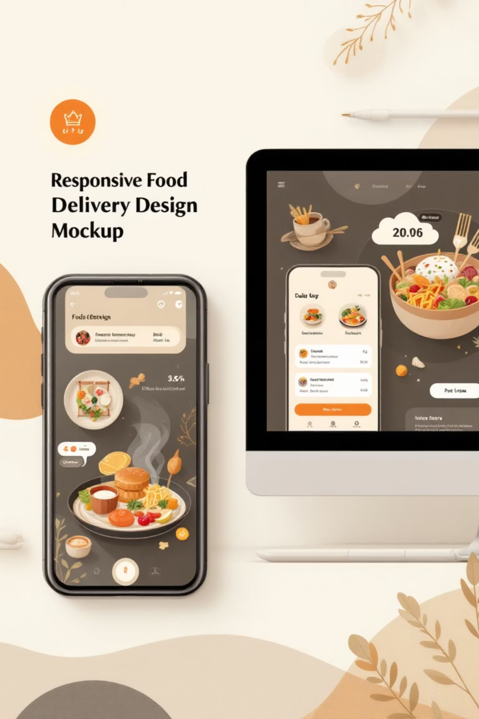



Design & User Experience
Responsive Design
Seamlessly adapts to mobile phones, tablets, and desktop computers for optimal user experience across all devices
Vibrant Color Scheme
Eye-catching combination of red, yellow, black, and white creates an appetizing and energetic brand identity
Intuitive Navigation
Clean navbar, compelling hero section, organized menu display, and smooth cart functionality using Poppins and Open Sans fonts

Slide 4

Development & Maintenance Strategy
01
02
Implementation Phase
Quality Assurance
Built using modern HTML5 for structure, CSS for styling, and JavaScript for interactive features and dynamic functionality
Continuous testing across different browsers and devices to ensure consistent performance and user experience
03
Ongoing Maintenance
Regular bug fixes, adding new restaurant partners, optimizing loading speed, and enhancing security measures
Combining technical skills with creative problem-solving to deliver a professional-grade food delivery platform

Slide 5
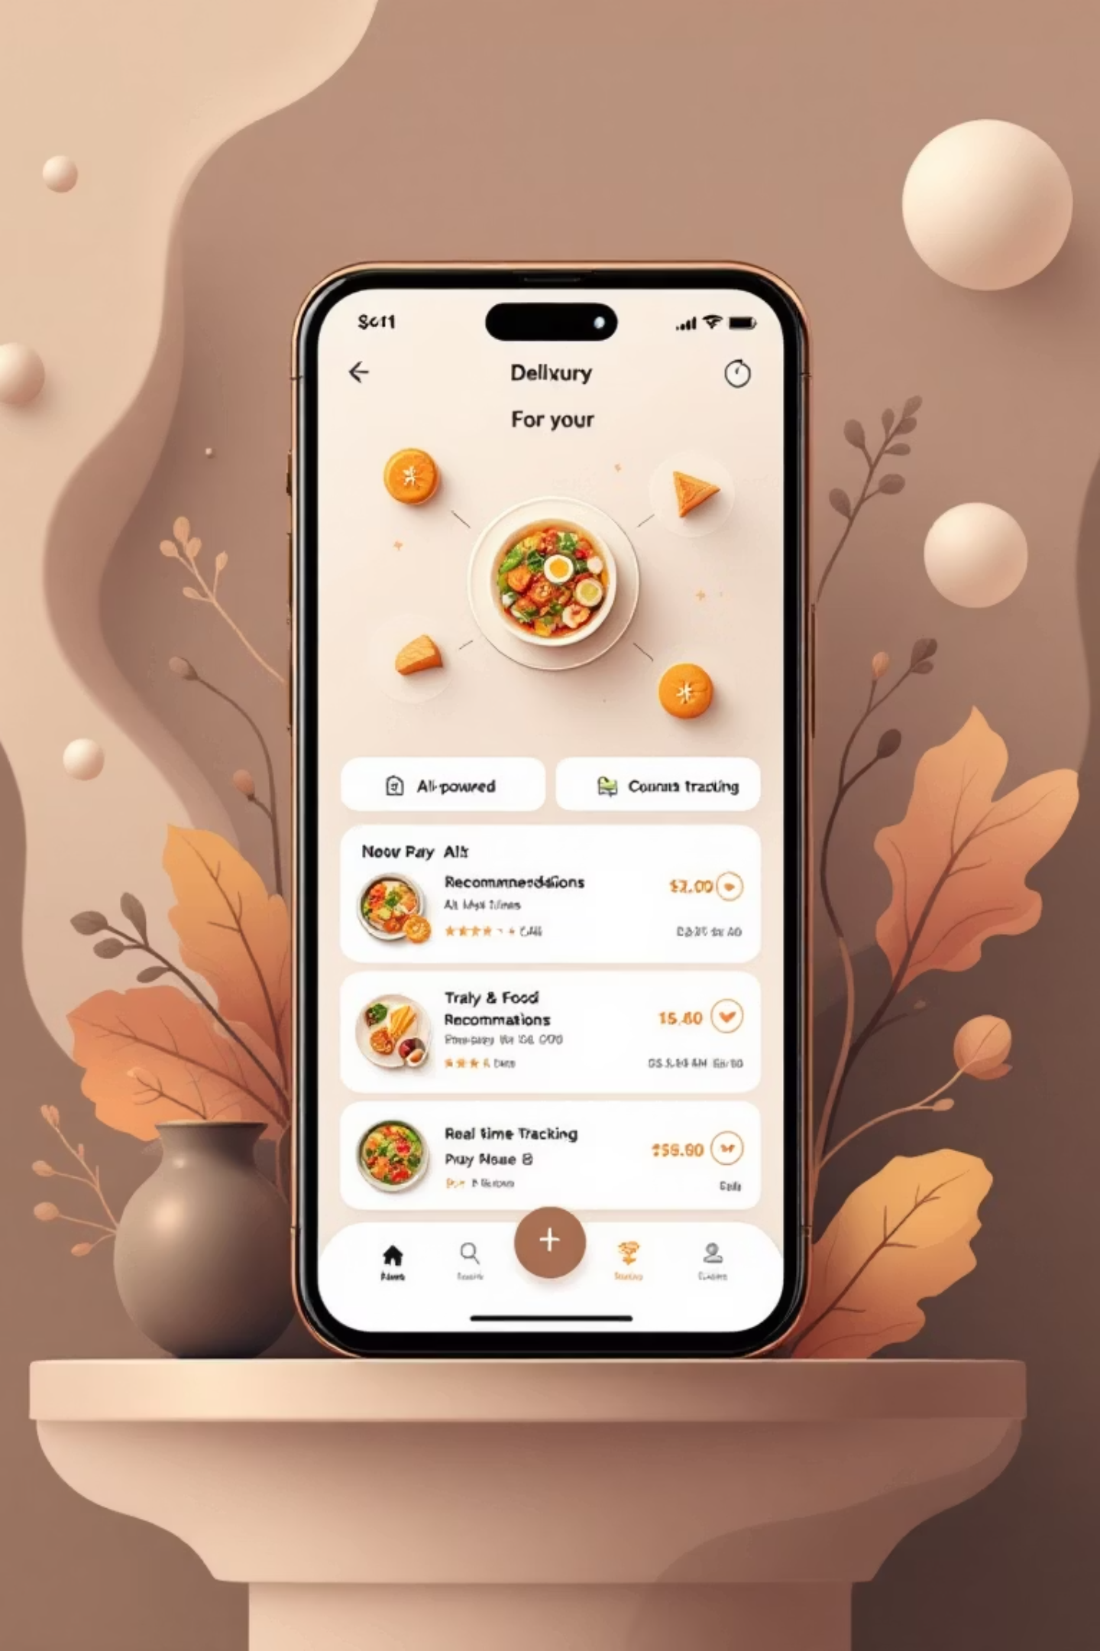




Future Vision
Making Food Delivery Simple, Fast & Reliable
Online Payments
Secure payment gateway integration for seamless transactions
AI Food Suggestions
Smart recommendations based on user preferences and order history
Mobile Application
Native mobile app for iOS and Android platforms
Live Order Tracking
Real-time delivery updates and GPS tracking for customers
Foodie Fleet represents the next generation of food delivery platforms, combining student innovation with professional web development practices.

